Slide 1
Divide and Conquer: Recurrence
Session 08
Henry Lucky, S.Kom. M.Kom.

Slide 2
Outline Materials
Session 08
Solving Recurrences
Substitution method
Recursion tree method
Master method

Slide 3
Learning outcomes
08
LO 1: Explain fundamental concept of analysis algorithms
LO 2: Apply algorithm techniques and methods
LO 3: Solve a problem using specific algorithm.
LO 4: Compare several algorithm design methods

Slide 4

Solving Recurrences
Ways to solve recurrences
After learning about divide-and-conquer algorithms for merge sort and matrix multiplication, we’ll explore several mathematical tools for solving recurrences-that is, for obtaining asymptotic $Θ$-, $O$-, or $Ω$-bounds on their solutions.
We want simple-to-use tools that can handle the most commonly occurring situations.
But we also want general tools that work, perhaps with a little more effort, for less common cases.

Slide 5
Solving Recurrences
Ways to solve recurrences
Examples:
T(n) = 2T(n/2) + Θ(n) ➔ T(n) = Θ(n lg n)
T(n) = 2T(n/2) + 1 ➔ T(n) = Θ(n)
T(n) = T(n-1) + n ➔ T(n) = Θ(n^2)
Three methods for solving recurrences
Substitution method
Recursion tree method
Master method

Slide 6
Substitution method
Definition
The most general method:
Guess the form of the solution.
Verify by induction.
Solve for constants.
[Assume that T(1) = Θ(1).]
Let’s guess O(n³) . (Prove O and Ω separately.)
Assume that T(k) ≤ ck³ for k < n .
Prove T(n) ≤ cn³ by induction.
Example: T(n) = 4T(n/2) + 100n

Slide 7
Substitution method
example
T
(
n
)
=
4
T
(
n
/
2
)
+
100n
≤
4
c
(
n
/
2
)
3
+
100n
=
(
c
/
2
)
n
3
+
100n
=
cn
3
−
((
c
/
2
)
n
3
−
100n
)
desired – residual
≤
cn
3
desired
whenever (c/2)n³ – 100n ≥ 0, for
example, if c ≥ 200 and n ≥ 1.
residual

Slide 8
Substitution method
example
We must also handle the initial conditions, that is, ground the induction with base cases.
Base: T(n) = Θ(1) for all n < n₀, where n₀ is a suitable constant.
For 1 ≤ n < n₀, we have “Θ(1)” ≤ cn³, if we pick c big enough.
This bound is not tight!

Slide 9
Substitution method
A tighter upper bound?
We shall prove that T(n) = O(n²).
Assume that T(k) ≤ ck² for k < n:
T
(
n
)
=
4
T
(
n
/
2
)
+
100n
≤
cn
2
+
100n
≤
cn
2
for no choice of c > 0. Lose!

Slide 10
Substitution method
A tighter upper bound!
IDEA: Strengthen the inductive hypothesis.
Subtract a low-order term.
Inductive hypothesis: T(k) ≤ c₁k² – c₂k for k < n.
T
(
n
)
=
4
T
(
n
/
2
)
+
100n
≤
4
(
c
(
n
/
2
)
2
−
c
(
n
/
2
))
+
100n
1
2
=
c
n
2
−
2
c
n
+
100n
1
2
=
c
n
2
−
c
n
−
(
c
n
−
)
1
2
100n
2
≤
c
n
2
−
c
n
if c₂ > 100.
1
2
Pick c₁ big enough to handle the initial conditions.

Slide 11
Recursion-tree method
definition
A recursion tree models the costs (time) of a recursive execution of an algorithm.
The recursion tree method is good for generating guesses for the substitution method.
The recursion-tree method can be unreliable, just like any method that uses ellipses (…).
The recursion-tree method promotes intuition, however.

Slide 12

recursion tree method
example
Solve $T\left(n\right)=3T\left(\frac{n}{4}\right)+Θ(n^{2})$
$$T\left(n\right)$$

Slide 13



recursion tree method
example
Solve $T\left(n\right)=3T\left(\frac{n}{4}\right)+Θ(n^{2})$
$$cn^{2}$$
$$T\left(\frac{n}{4}\right)$$
$$T\left(\frac{n}{4}\right)$$
$$T\left(\frac{n}{4}\right)$$

Slide 14












recursion tree method
example
Solve $T\left(n\right)=3T\left(\frac{n}{4}\right)+Θ(n^{2})$
$$cn^{2}$$
$$c{\left(\frac{n}{4}\right)}^{2}$$
$$c{\left(\frac{n}{4}\right)}^{2}$$
$$c{\left(\frac{n}{4}\right)}^{2}$$
$$T\left(\frac{n}{16}\right)$$
$$T\left(\frac{n}{16}\right)$$
$$T\left(\frac{n}{16}\right)$$
$$T\left(\frac{n}{16}\right)$$
$$T\left(\frac{n}{16}\right)$$
$$T\left(\frac{n}{16}\right)$$
$$T\left(\frac{n}{16}\right)$$
$$T\left(\frac{n}{16}\right)$$
$$T\left(\frac{n}{16}\right)$$

Slide 15















recursion tree method
example
Solve $T\left(n\right)=3T\left(\frac{n}{4}\right)+Θ(n^{2})$
$$cn^{2}$$
$$cn^{2}$$
$$c{\left(\frac{n}{4}\right)}^{2}$$
$$c{\left(\frac{n}{4}\right)}^{2}$$
$$\frac{3}{16}cn^{2}$$
$$c{\left(\frac{n}{4}\right)}^{2}$$
$$\log_{4}n$$
$${\left(\frac{3}{16}\right)}^{2}cn^{2}$$
$$c{\left(\frac{n}{16}\right)}^{2}$$
$$c{\left(\frac{n}{16}\right)}^{2}$$
$$c{\left(\frac{n}{16}\right)}^{2}$$
$$c{\left(\frac{n}{16}\right)}^{2}$$
$$c{\left(\frac{n}{16}\right)}^{2}$$
$$c{\left(\frac{n}{16}\right)}^{2}$$
$$c{\left(\frac{n}{16}\right)}^{2}$$
$$c{\left(\frac{n}{16}\right)}^{2}$$
$$c{\left(\frac{n}{16}\right)}^{2}$$
$Θ(1)$. $Θ\left(1\right)$. $Θ(1)$. $Θ(1)$ $Θ\left(1\right)$ $Θ(1)$ $Θ(1)$ $Θ\left(1\right)$ $Θ(1)$ $Θ\left(1\right) …$ $Θ\left(1\right)$. $Θ(1)$
$$Θ(n^{\log_{4}3})$$
$${3^{\log_{4}n}=n}^{\log_{4}3}$$
Total: $O(n^{2})$

Slide 16
recursion tree method
example
Solve T(n) = T(n/4) + T(n/2) + n²:

Slide 17
recursion tree method
example
Solve T(n) = T(n/4) + T(n/2) + n²:
T(n)

Slide 18
recursion tree method
example
Solve T(n) = T(n/4) + T(n/2) + n²:
n²
T(n/4)
T(n/2)

Slide 19
recursion tree method
example
Solve T(n) = T(n/4) + T(n/2) + n²:
n²
(n/4)²
(n/2)²
T(n/16)
T(n/8)
T(n/8)
T(n/4)

Slide 20
recursion tree method
example
Solve T(n) = T(n/4) + T(n/2) + n²:
n²
(n/4)²
(n/2)²
(n/16)²
(n/8)²
(n/8)²
(n/4)²
…
Θ(1)

Slide 21
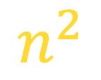
recursion tree method
example
Solve T(n) = T(n/4) + T(n/2) + n²:
n²
$$n^{2}$$
(n/4)²
(n/2)²
(n/16)²
(n/8)²
(n/8)²
(n/4)²
…
Θ(1)

Slide 22
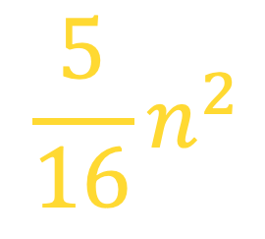
recursion tree method
example
Solve T(n) = T(n/4) + T(n/2) + n²:
n²
$$n^{2}$$
(n/4)²
(n/2)²
$$\frac{5}{16}n^{2}$$
(n/16)²
(n/8)²
(n/8)²
(n/4)²
…
Θ(1)

Slide 23
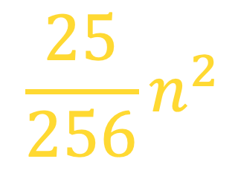
recursion tree method
example
Solve T(n) = T(n/4) + T(n/2) + n²:
n²
$$n^{2}$$
(n/4)²
(n/2)²
$$\frac{5}{16}n^{2}$$
(n/16)²
(n/8)²
(n/8)²
(n/4)²
$$\frac{25}{256}n^{2}$$
…
…
Θ(1)

Slide 24
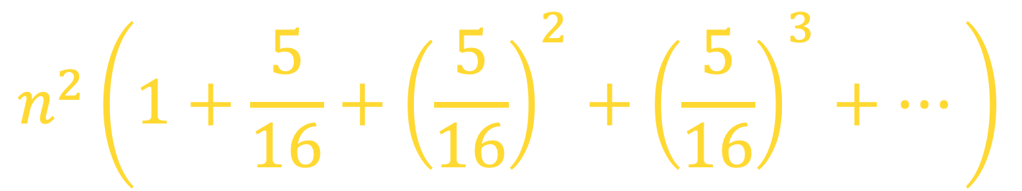
recursion tree method
example
Solve T(n) = T(n/4) + T(n/2) + n²:
n²
$$n^{2}$$
(n/4)²
(n/2)²
$$\frac{5}{16}n^{2}$$
(n/16)²
(n/8)²
(n/8)²
(n/4)²
$$\frac{25}{256}n^{2}$$
…
…
Θ(1)
$$n^{2}\left(1+\frac{5}{16}+{\left(\frac{5}{16}\right)}^{2}+{\left(\frac{5}{16}\right)}^{3}+…\right)$$
Total =
= Θ(n²)
geometric series

Slide 25
The master method
The master method applies to recurrences of the form
T(n) = a T(n/b) + f (n) ,
where a ≥ 1, b > 1, and f is asymptotically positive.

Slide 26
The Master method
Idea of master theorem
Recursion tree:
f (n)
f (n)
a
f (n/b)
f (n/b)
…
f (n/b)
a f (n/b)
a
h = log_{b}n
f (n/b²)
f (n/b²)
…
f (n/b²)
a² f (n/b²)
…
…
#leaves = a^{h}
= a^{logbn}
= n^{logba}
n^{logba}Τ (1)
Τ (1)

Slide 27

The Master Method
Three common cases: case 1
Compare f (n) with n^{logba}:
f (n) = O(n^{logba – ε}) for some constant ε > 0.
f (n) grows polynomially slower than n^{logba} (by an n^{ε} factor).
Solution: T(n) = Θ(n^{logba}) .

Slide 28
The Master Method
Three common cases: case 1
Recursion tree:
f (n)
f (n)
a
f (n/b)
f (n/b)
…
f (n/b)
a f (n/b)
a
h = log_{b}n
f (n/b²)
f (n/b²)
…
f (n/b²)
a² f (n/b²)
CASE 1: The weight increases geometrically from the root to the leaves. The leaves hold a constant fraction of the total weight.
…
…
n^{logba}Τ (1)
Τ (1)
Θ(n^{logba})

Slide 29
The Master Method
Three common cases: case 2
Compare f (n) with n^{logba}:
f (n) = Θ(n^{logba} lg^{k}n) for some constant k ≥ 0.
f (n) and n^{logba} grow at similar rates.
Solution: T(n) = Θ(n^{logba} lg^{k+1}n) .

Slide 30
The Master Method
Three common cases: case 2
Recursion tree:
f (n)
f (n)
a
f (n/b)
f (n/b)
…
f (n/b)
a f (n/b)
a
h = log_{b}n
f (n/b²)
f (n/b²)
…
f (n/b²)
a² f (n/b²)
…
…
CASE 2: (k = 0) The weight is approximately the same on each of the log_{b}n levels.
n^{logba}Τ (1)
Τ (1)
Θ(n^{logba}lg n)

Slide 31
The Master Method
SUB TITLE
Three common cases: case 3
Compare f (n) with n^{logba}:
f (n) = Ω(n^{logba + ε}) for some constant ε > 0.
f (n) grows polynomially faster than n^{logba} (by an n^{ε} factor),
and f (n) satisfies the regularity condition that a f (n/b) ≤ c f (n) for some constant c < 1.
Solution: T(n) = Θ( f (n) ) .

Slide 32
The Master Method
SUB TITLE
Three common cases: case 3
Recursion tree:
f (n)
f (n)
a
f (n/b)
f (n/b)
…
f (n/b)
a f (n/b)
a
h = log_{b}n
f (n/b²)
f (n/b²)
…
f (n/b²)
a² f (n/b²)
CASE 3: The weight decreases geometrically from the root to the leaves. The root holds a constant fraction of the total weight.
…
…
n^{logba}Τ (1)
Τ (1)
Θ( f (n))

Slide 33
The Master Method
SUB TITLE
Three common cases: case 3
Ex. T(n) = 4T(n/2) + n
a = 4, b = 2 ⇒ n^{logba} = n²; f (n) = n.
CASE 1: f (n) = O(n^{2 – ε}) for ε = 1.
∴ T(n) = Θ(n²).
Ex. T(n) = 4T(n/2) + n²
a = 4, b = 2 ⇒ n^{logba} = n²; f (n) = n².
CASE 2: f (n) = Θ(n²lg⁰n), that is, k = 0.
∴ T(n) = Θ(n²lg n).

Slide 34
The Master Method
SUB TITLE
Three common cases: case 3
Ex. T(n) = 4T(n/2) + n³
a = 4, b = 2 ⇒ n^{logba} = n²; f (n) = n³.
CASE 3: f (n) = Ω(n^{2 + ε}) for ε = 1
and 4(cn/2)³ ≤ cn³ (reg. cond.) for c = 1/2.
∴ T(n) = Θ(n³).
Ex. T(n) = 4T(n/2) + n²/lg n
a = 4, b = 2 ⇒ n^{logba} = n²; f (n) = n²/lg n.
Master method does not apply. In particular, for every constant ε > 0, we have n^{ε} = ω(lg n).

Slide 35
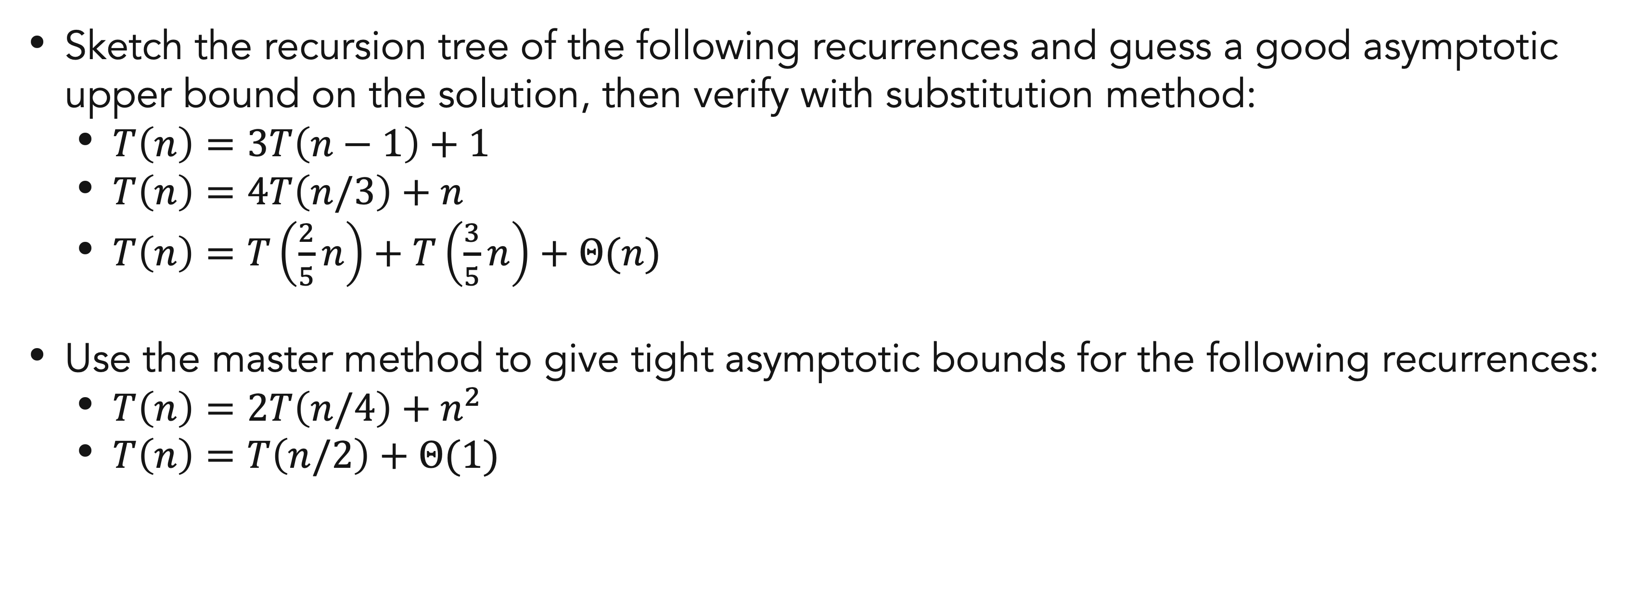
Exercises
8
Sketch the recursion tree of the following recurrences and guess a good asymptotic upper bound on the solution, then verify with substitution method:
$T\left(n\right)=3T\left(n−1\right)+1$
$T\left(n\right)=4T\left(n/3\right)+n$
$T\left(n\right)=T\left(\frac{2}{5}n\right)+T\left(\frac{3}{5}n\right)+Θ(n)$
Use the master method to give tight asymptotic bounds for the following recurrences:
$T\left(n\right)=2T\left(n/4\right)+n^{2}$
$T\left(n\right)=T\left(n/2\right)+Θ(1)$

Slide 36
References
Thomas H. Cormen. (2022). Introduction to algorithms: Fourth edition. The MIT Press. Chapter 4.
Shafi Goldwasser. (2004). Introduction to Algorithms – Spring 2004. Massauchetts Institute of Technology. Lecture 2.

Slide 37
Thank you
Recurrences
September, 2023

